Slide 1
Predictive Analysis Using Linear Regression
Presented By:
Prajwal R
1NT15CS417

Slide 2
ABSTRACT
Predictive analytics encompasses a variety of statistical techniques from predictive modelling, machine learning, and data mining that analyze current and historical facts to make predictions about future or otherwise unknown events.
In business, predictive models exploit patterns found in historical and transactional data to identify risks and opportunities. Models capture relationships among many factors to allow assessment of risk or potential associated with a particular set of conditions, guiding decision making for candidate transactions.

Slide 3
INTRODUCTION
Predictive models are models of the relation between the specific performance of a unit in a sample and one or more known attributes and features of the unit. The objective of the model is to assess the likelihood that a similar unit in a different sample will exhibit the specific performance. This category encompasses models in many areas, such as marketing, where they seek out subtle data patterns to answer questions about customer performance, or fraud detection models. Predictive models often perform calculations during live transactions, for example, to evaluate the risk or opportunity of a given customer or transaction, in order to guide a decision.

Slide 4
Analytical Technique Used
Linear regression model:
The linear regression model analyzes the relationship between the response or dependent variable and a set of independent or predictor variables. This relationship is expressed as an equation that predicts the response variable as a linear function of the parameters. These parameters are adjusted so that a measure of fit is optimized. Much of the effort in model fitting is focused on minimizing the size of the residual, as well as ensuring that it is randomly distributed with respect to the model predictions.

Slide 5
CASE STUDY
In this case we have taken an example of a classification of people based on their injury and deaths due to vehicular accidents.
Classification of people as the death count.
Implementation is done is R programming language.

Slide 6
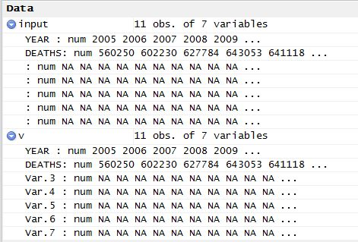
RESULTS

Slide 7
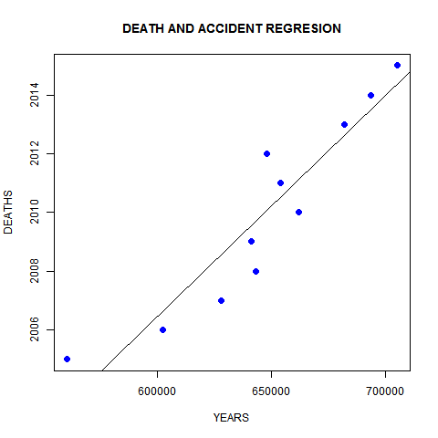

Slide 8
CONCLUSION
Success is better decision making. Previously with low volumes of data, intuitive decision making would work. As the data size has grown to incredible proportions, human ability to make completely intuitive decisions has been reduced. As a result, data-driven decision making has become more prevalent to ensure a reasonable path for success. This situation makes sense as it is easy to see that data are not diminishing but rather increasing.

Slide 9
REFERENCES
Wikipedia.org
Tutorialspoint.org
http://www.kdnuggets.com

Slide 10
Thank You

